Slide 1
Group Activity I: Spot the Fake
ESSIR 2015
Thessaloniki, Sep 3-4, 2015

Slide 2
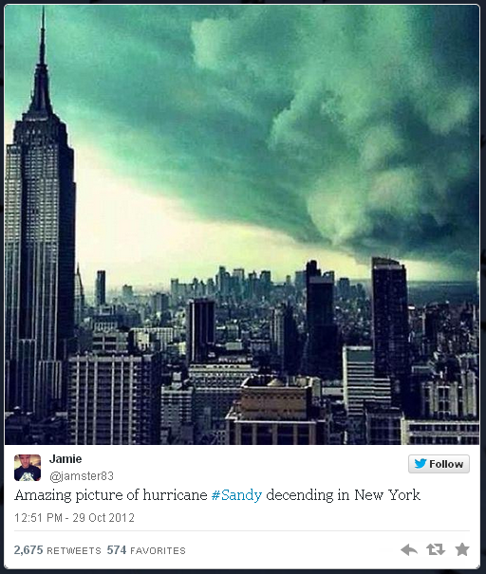
Real or Fake?

Slide 3
Real or Fake?
Real photo
captured April 2011 by WSJ
but
heavily tweeted during Hurricane Sandy
(29 Oct 2012)
Tweeted by multiple sources & retweeted multiple times
Original online at:
http://blogs.wsj.com/metropolis/2011/04/28/weather-journal-clouds-gathered-but-no-tornado-damage/

Slide 4
Activity Overview
Group gathering
Example labeling
Result Analysis
Discussion
Game!

Slide 5
Example Labeling
The activity leader will show you a number of results to label
Each result will be a tweet containing an image and the Twitter profile of the author
Labeling should happen relatively fast (use spreadsheet or piece of paper)
Take notes on what drove your decision

Slide 6
Example
TWEET

Slide 7
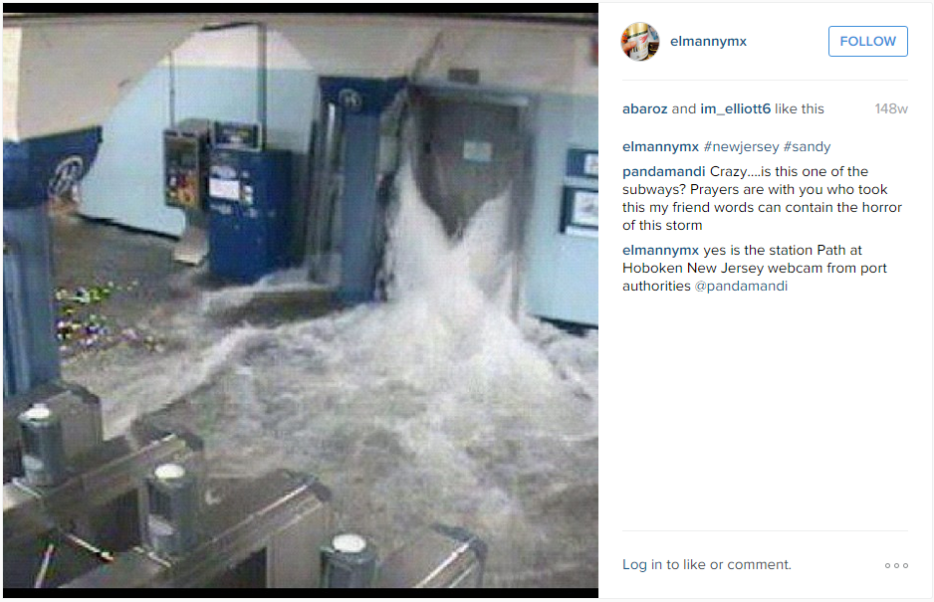
Example
LINKED CONTENT

Slide 8
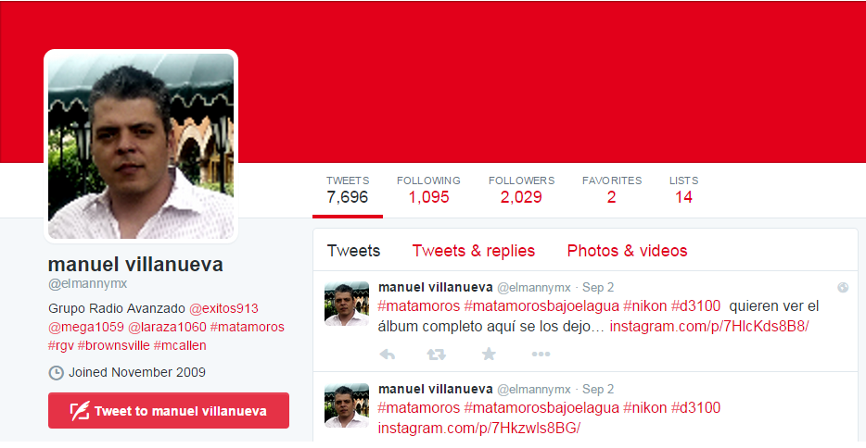
Example
AUTHOR

Slide 9
Result Analysis
After the labeling, you will be given the correct labels
Individual annotations by group members should be collected by the “data analyst” of the group
You could compute some interesting measures:
what was the overall fake detection accuracy of the group (using majority voting) and what were the individual responses?
which examples were the most challenging ones?
who was the best fake spotter of the group?

Slide 10
Discussion
Several interesting questions arise:
what were the most important clues you used to decide whether a tweet was fake or not?
what kind of additional information would you need to make better decisions?
what kind of approaches could you devise to automate the task?
which other platforms (besides Twitter) and what other kind of content (besides tweets+images) would you face similar problems and be able to apply similar approaches?
how does this problem relate to or could affect your research?

Slide 11
Can you Game Us?
Until tomorrow afternoon (before the group activity), you need to create and post 5 tweets with images using hashtags #essir2015 #fakeornot
Out of the 5 tweets, 4 should be real, and only one fake. Try to be creative!
Our task is then to spot the fake!

