Slide 1
Group Activity II: Privacy in a Connected World
ESSIR 2015
Thessaloniki, Sep 3-4, 2015

Slide 2
Personal Information in Social Media and Query Logs
social media presence (social privacy)
query logs (institutional privacy)
2015-09-03 13:55 car battery
2015-09-03 13:57 present for girlfriend
2015-09-03 13:59 best rings thessaloniki
2015-09-03 14:01 cool clothes online
2015-09-03 14:02 hip shoes online
2015-09-03 14:05 ipa beers thessaloniki
2015-09-03 14:07 hoppy pub

Slide 3
Activity Overview
Group gathering
Questionnaire (5 minutes)
Result Analysis
Discussion

Slide 4
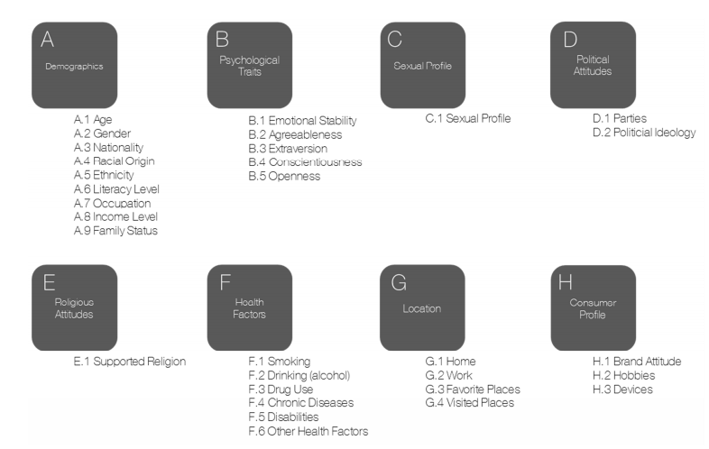
A Taxonomy of Personal Information

Slide 5
Questionnaire
Group 3:
https://docs.google.com/forms/d/1LOaEgUsnk3c-aEeICQOyTjKeI3tC98iehH4XryKPxcA/viewform
Group 4:
https://docs.google.com/forms/d/1C89D65OInjkeee387ANfdVWClDtLD0TyslvTxh_mww0/viewform

Slide 6
Result Analysis
After the questionnaire is filled by all group members, the “data analyst” of the group will be given access to the collected results. Please contact Theodora/Akis.
You could compute some interesting measures:
what is considered the most sensitive information?
is such information publicly available by group members or can it be easily inferred?
are group members worried about this?

Slide 7
Discussion
Several interesting questions arise:
what/how much information would be willing to reveal online for better search/social media services?
what kind of information would you need to make better decisions about what to reveal online?
what should social media platforms and search engines do to preserve the privacy of their users?
how does this problem relate to or could affect your research?

